Slide 1
Assessment of individuals and social situations
Pawel Ziemianski, Ph.D.

Slide 2
RULES USED BY INDIVIDUALS WHEN ASSESSING THE SOCIAL WORLD
Saving the mental effort
Building a positive self-image
Maintaining control
Today’s class is divided among these sections, and relevant phenomena are discussed.

Slide 3
Saving the mental effort

Slide 4
Activity – please read the text below and try to memorize it.
The procedure is actually quite simple. First you arrange things into different groups. Of course, one pile may be sufficient depending on how much there is to do. If you have to go somewhere else due to lack of facilities that is the next step, otherwise you are pretty well set. It is important not to overdo things. That is, it is better to do too few things at once than too many. In the short run this may not seem important but complications can easily arise. A mistake can be expensive as well.
At first the whole procedure will seem complicated. Soon, however, it will become just another facet of life. It is difficult to foresee any end to the necessity for this task in the immediate future, but then one never can tell. After the procedure is completed one arranges the materials into different groups again. Then they can be put into their appropriate places. Eventually they will be used once more and the whole cycle will then have to be repeated. However, that is part of life.
Source: Bransford, J. D., & Johnson, M. K. (1972). Contextual prerequisites for understanding: Some investigations of comprehension and recall. Journal of verbal learning and verbal behavior, 11(6), 717-726.

Slide 5
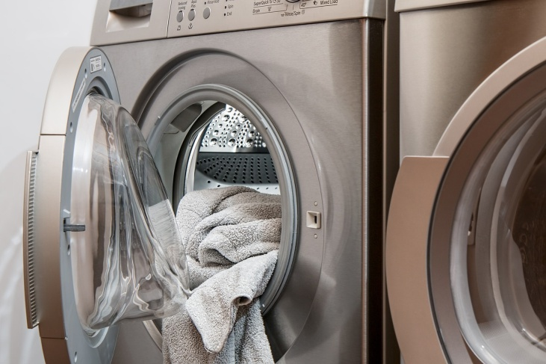
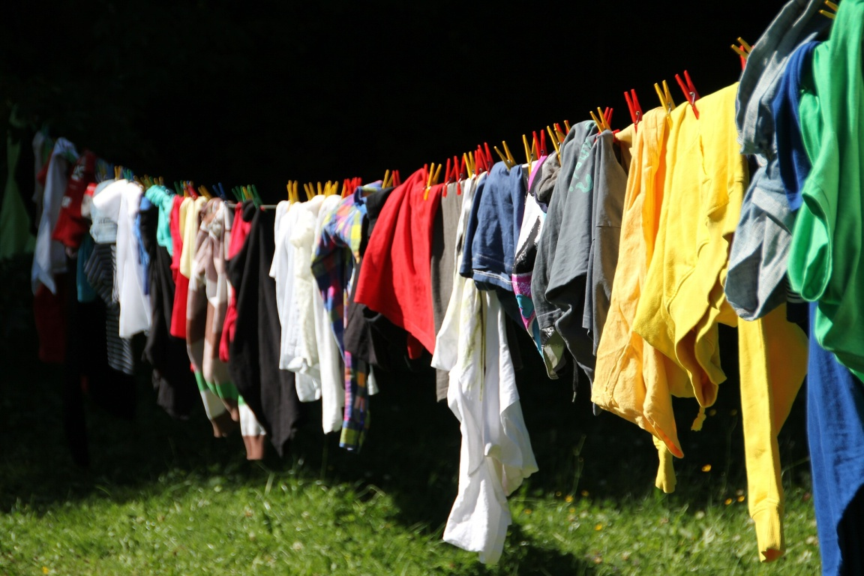
How much can you remember?
What if you were shown these pictures before reading?

Slide 6
Building and maintaining positive self-image

Slide 7
Group A and B
Researchers found that people with low self-confidence are more sensitive to flattery and compliments than those with high self-confidence.
Why do you think this is true?
Do you find this result surprising? Provide your assessment on the scale from 1 (not surprising at all) to 5 (very surprising).

Slide 8
Group A and B
Researchers found that people with high self-confidence are more sensitive to flattery and compliments than those with low self-confidence.
Why do you think this is true?
Do you find this result surprising? Provide your assessment on the scale from 1 (not surprising at all) to 5 (very surprising).

Slide 9
False consensus effect
It pertains to a tendency to overestimate the extent to which others agree with our opinions
Do you agree with the following statements?:
Burger King is better than McDonald’s
Android is better than iOS
Playstation is superior to XBOX
What percentage of people in your group do you believe would agree with you?

Slide 10
SELF-SERVING BIAS
The self-serving bias refers to the tendency to take credit for successful outcomes in life, but to blame the situation or other people for failing outcomes.

Slide 11
HAVING CONTROL

Slide 12
Hindsight bias helps people believe in their ability to predict the reality (and control it)
Captain Hindsight was a character included in the South Park series:
https://www.youtube.com/watch?v=gdbjw27QPJQ

Slide 13
Self-fulfilling prophecy
A self-fulfilling prophecy is a process through which someone’s expectations about a situation or another person leads to the fulfillment of those expectations.
Correspondence bias also serves the process of maintaining the feeling of controlling social situations

Slide 14
Four methaphors of people as self-perceivers (Robins, John, 1997)
The Scientist
The Consistency Seeker
The Politician
The Egoist

Slide 15
The Scientist
Festinger (1954) : "There is a motivation in the human organism to hold correct opinions, beliefs, and ideas . . . and to know precisely what his abilities enable him to do in this world" (p. 194)

Slide 16
The Consistency Seeker
"Stable self-conceptions act like the rudder of a ship, bolstering people's confidence in their ability to navigate through the sometimes murky seas of everyday social life" (Swann, Pelham, Krull, 1989, p. 783)

Slide 17
The Politician
„Politicians are striving to present themselves in ways that create the most favorable impressions on others” (Robbins, John, 1997)

Slide 18
The Egoist
"Normal human thought is marked not by accuracy but by positive self-enhancing illusions" (Taylor, 1989, p. 7)

Slide 19
Sources and recommended readings
Moskowitz, G. B. (2005). Social cognition: Understanding self and others. Guilford Press.
Robins, R. W., & John, O. P. (1997). The quest for self-insight: Theory and research on accuracy and bias in self-perception. In Handbook of personality psychology (pp. 649-679). Academic Press.

