Slide 1
Ishikawa Diagram
Quality tool

Slide 2
Ishikawa diagram
(also called fishbone diagram, herringbone diagram, cause-and-effect diagram, or Fishikawa) is created by Kaoru Ishikawa - it shows the causes of a specific event/ problem.
The fishbone diagram identifies many possible causes for an effect or problem. It can be used to structure a brainstorming session. It immediately sorts ideas into useful categories.

Slide 3
Steps
Identify a problem (head of fish).
Use brainstorming to identify the main categories of causes of the problem. If this is difficult, use general headings (proposed): Methods, Machines (equipment), People (personnel, workforce), Materials, Measurement, Environment…
If category does’t match, you can skip it.

Slide 4
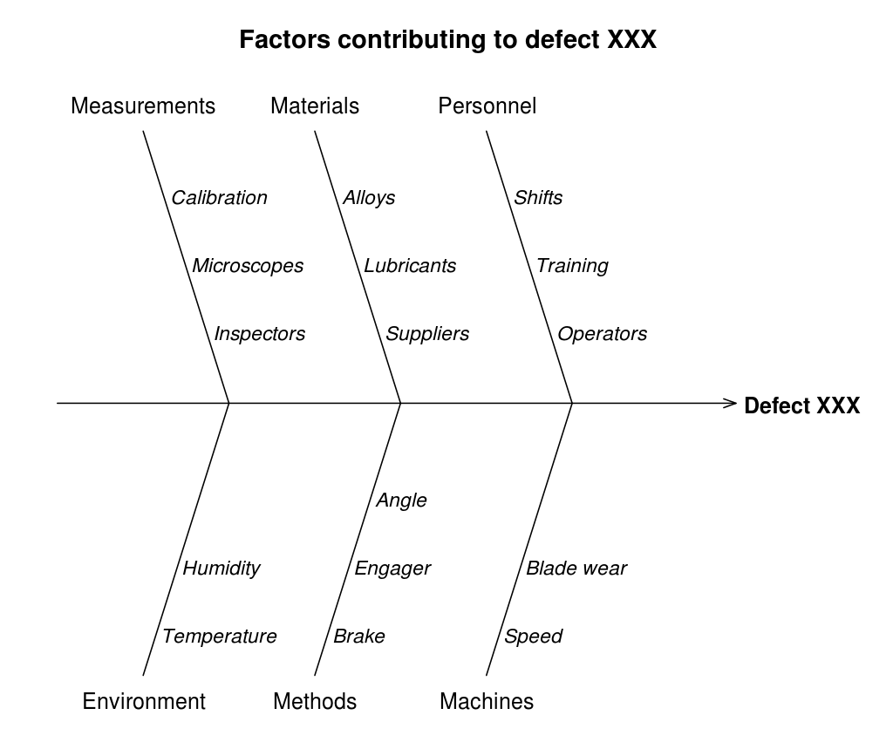

Slide 5
5 why method

Slide 8
5 WHY
Notes:
https://www.youtube.com/watch?v=B-M3YlA2KDg

Slide 9
Ishikawa Diagram
Notes:
https://www.youtube.com/watch?v=mLvizyDFLQ4

Slide 10
