Slide 1
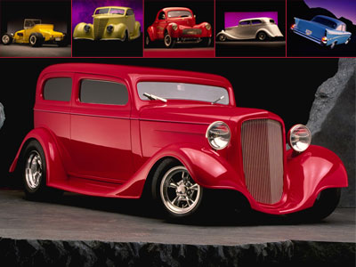
The History of Cars
Your Name

Slide 2
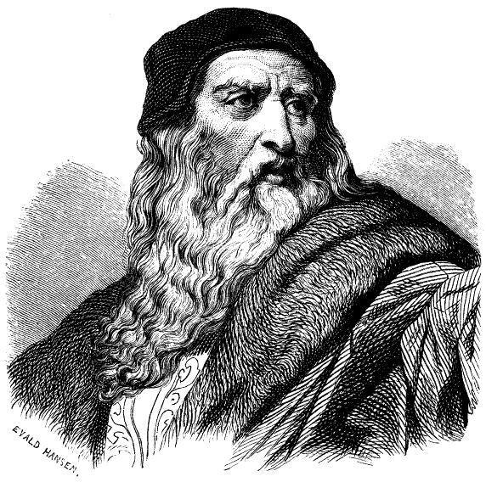
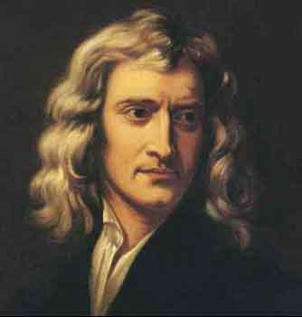
First cars
The automobile as we know it was not invented in a single day by a single inventor. The history of the automobile reflects an evolution that took place worldwide.
Starting with the first theoretical plans for a motor vehicle that had been drawn up by both Leonardo da Vinci and Isaac Newton.
Draw arrows!

Slide 3
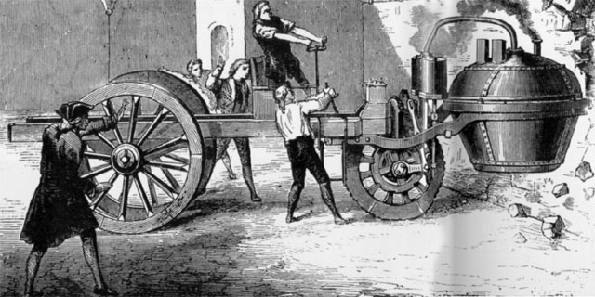
First cars
The first vehicle to move under its own power for which there is a record was designed by Nicholas Joseph Cugnot and constructed by M. Brezin in 1769. A replica of this vehicle is on display at the Conservatoire des Arts et Metiers, in Paris.

Slide 4
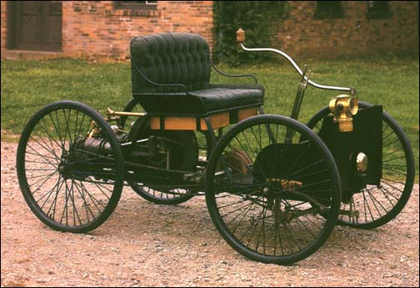
First cars
Ford has become the legend of world’s motorization
Henry’s Ford factories are still the best example for business developing
Henry’s Ford first car

Slide 5
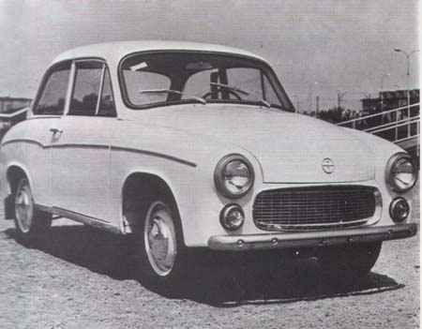
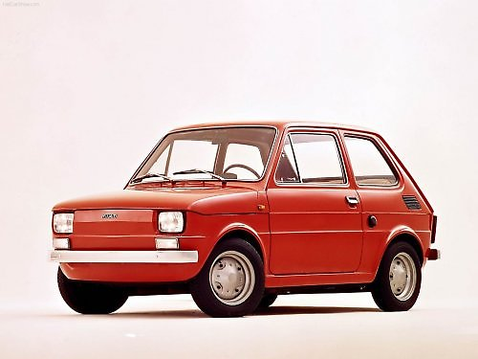
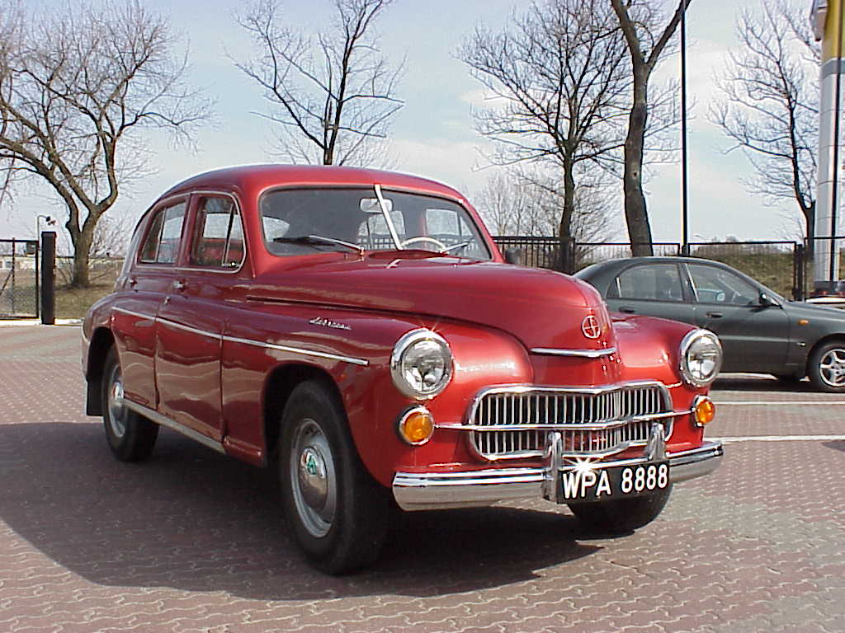
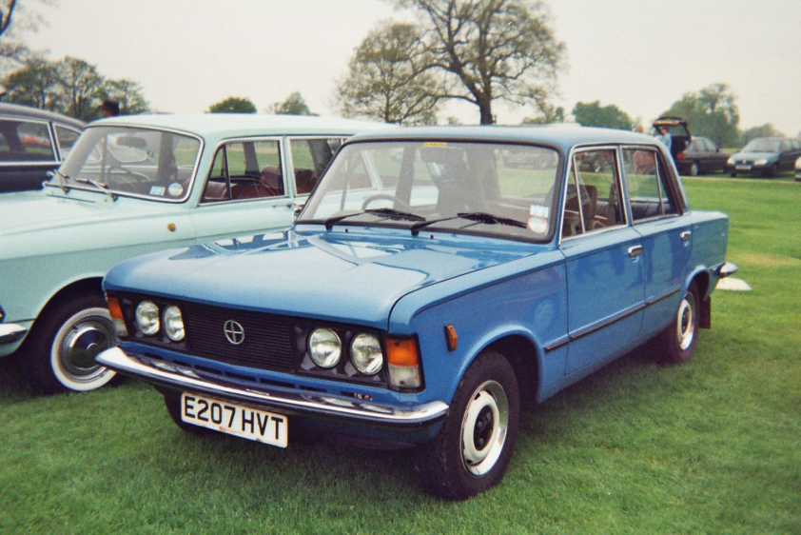
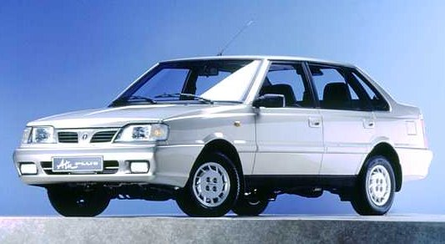
The classic of Polish motorization

Slide 6
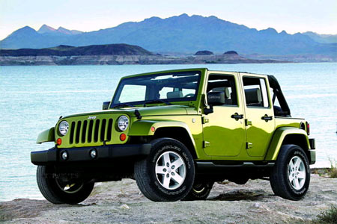
Off road
People that like adventures often buy off-road cars.
The most popular off-road car is still Jeep.

Slide 7
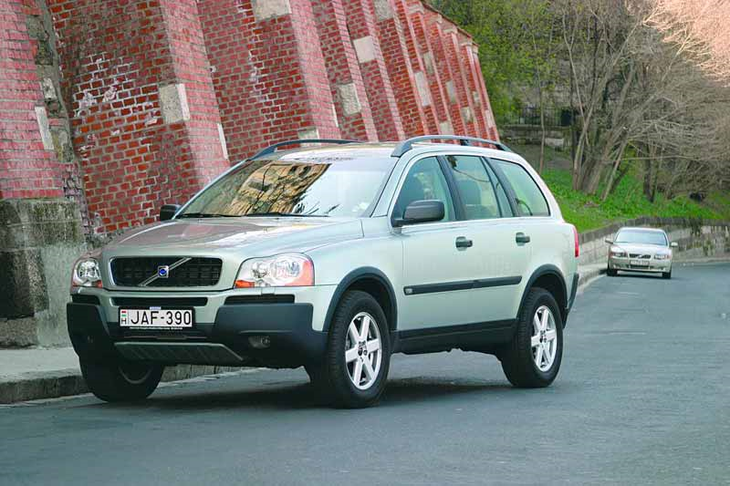
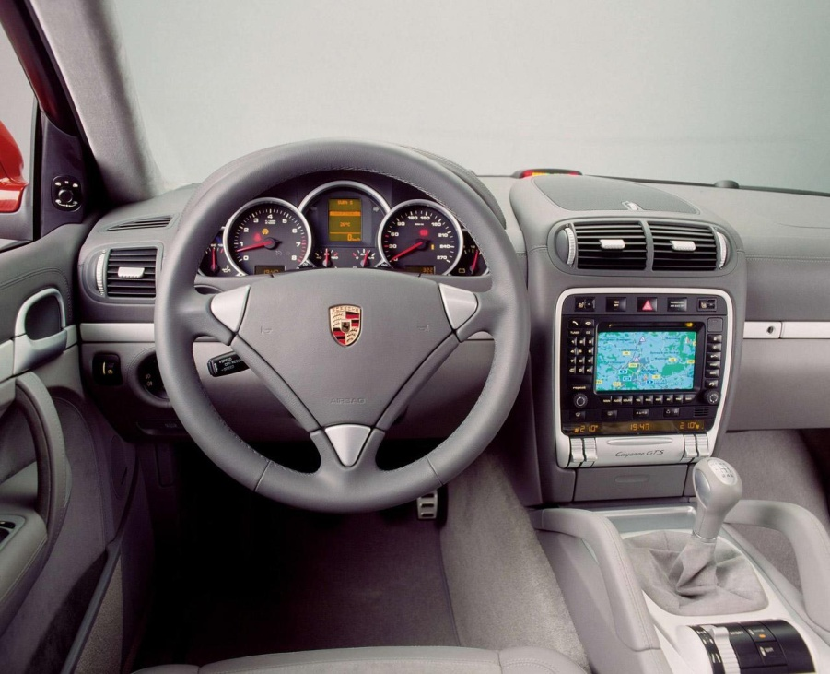
What is SUV
When you have lot of money and want to have something more than off-road car, you should buy brand new SUV.
SUV are usually luxury cars. They are something between off-road car and limousine.
From mondey to friday driving to the job and off-road on weekend.

Slide 8
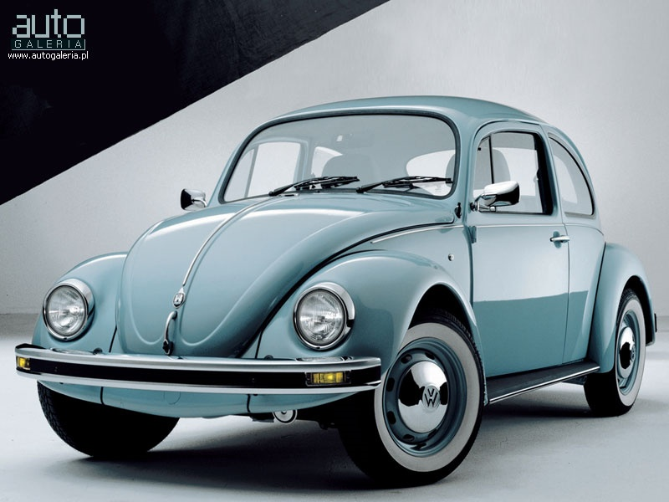
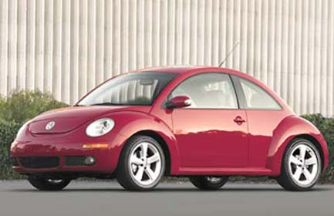
Cars for all
In Germany F.Porsche constructed the first Volkswagen (the car for people)
Today his car looks much better and costs too

Slide 9
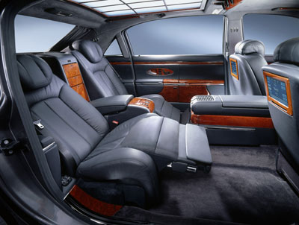
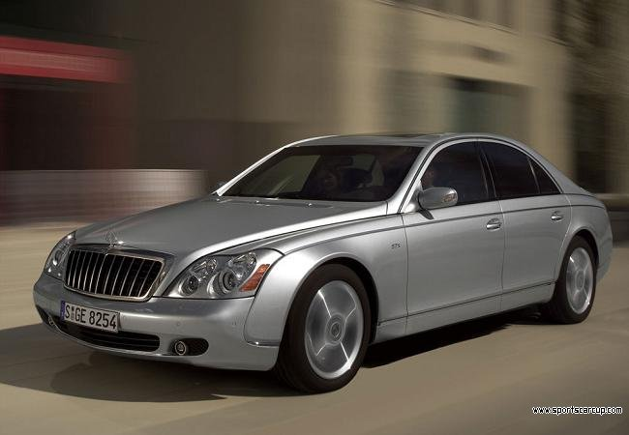
Cars not for all
When society was enriching, wants more luxury and comfortable cars.
Maybach costs about 300 000 $ and is more luxury than people’s flat.

Slide 10
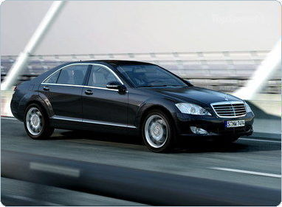
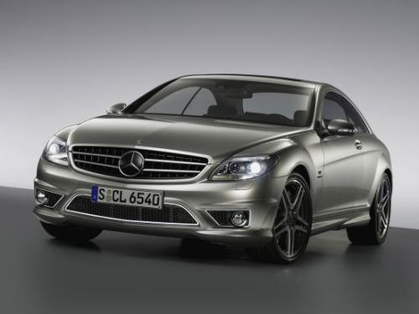
Cars not for all
Mercedes is still the leader in selling luxury cars.

Slide 11
The End
Thank you for attention

