Slide 1
Heuristics and biases in decision making
Paweł Ziemiański, Ph.D.

Slide 2
What you should expect in the near future
No meetings at the university until April,13th
Course online – presentations, readings and tasks
Tasks will need to be completed by you and submitted on the e-learning platform
First task deadline – Monday, March 30th
Decision about tests will be taken in due time, depending on the lockdown duration
In case you need any additional information, please contact me via email or use the course chat

Slide 3
Heuristics and biases in decision making
Paweł Ziemiański, Ph.D.

Slide 4
Aim of today’s class
Learn about major heuristics and biases in decision making
Consider their causes and effects

Slide 5
What is a heuristic?
Heuristics are rules-of-thumb that can be applied to guide decision-making based on a limited subset of the available information. Because they rely on less information, heuristics are assumed to facilitate faster decision-making than strategies that require more information.
American Psychological Association
Heuristic - a simplified thinking rule which allows to formulate a judgment without analyzing most of the information on which the judgement should be based. Heuristics are unconsciously used "shortcuts" in information processing.
Bogdan Wojciszke
Heuristic - in psychology, heuristics are simple, efficient rules, learned or hard-coded by evolutionary processes, that have been proposed to explain how people make decisions, come to judgements, and solve problems typically when facing complex problems or incomplete information. Researchers test if people use those rules with various methods. These rules work well under most circumstances, but in certain cases lead to systematic errors or cognitive biases.
Wikipedia

Slide 6
What is a bias?
Cognitive biases are systematic patterns of deviation from norm or rationality in judgment.
(Haselton, Nettle, Andrews, 2005)
Bias is a systematic error [which a person is prone] to make in specified circumstances
(Kahneman, 2012)
It means that heuristics (our shortcuts) may result in a biased judgement (but do not have to).

Slide 7
First activity –guess the rule
Numbers | Do they fit the rule? | The rule | Certainty

Slide 8
Confirmation bias
”Confirmation bias, as the term is typically used in the psychological literature, connotes the seeking or interpreting of evidence in ways that are partial to existing beliefs, expectations, or a hypothesis in hand.” (Nickerson, 1998)
It refers to:
a) a way of searching for the information
b) its interpretation
c) and the way in which it is remembered (or forgotten)

Slide 9
A real life example
“This is the president’s vision,” said Peter Navarro, Trump’s ascendant trade adviser. “My function, really, as an economist is to try to provide the underlying analytics that confirm his intuition. And his intuition is always right in these matters”
https://bloom.bg/2Fv7yEm

Slide 10
Psychologist’s reply
If you think anyone's intuition is always right, you’re not thinking.
Analytics exist to challenge intuition, not confirm it.
Falling victim to blatant confirmation bias is bad. Saying it’s your job as an economist is even worse.
Adam Grant on Twitter

Slide 11
Kathleen Hartnett White
Kathleen Hartnett White is a Republican American government official and environmental policy advisor. Currently serving as a senior fellow at the free-market think tank Texas Public Policy Foundation. She was nominated by President Donald Trump to lead the Council on Environmental Quality; the nomination was later withdrawn.
Source: https://en.wikipedia.org/wiki/Kathleen_Hartnett_White
https://www.youtube.com/watch?v=xykBJLfxDFI

Slide 12
Why do we fall pray to effects of biases? – on the example of the confirmation bias
Reasons for them can be either cognitive or emotional
They include following (Casad, 2007):
confirmation bias is an effective way to process information – there are certain cognitive limitations of human mind and we need shortcuts
confirmation bias helps people feel better about themselves (it is connected with the protection of one’s self-esteem) – people feel that they are more intelligent if they hold accurate beliefs.

Slide 13
How can confirmation bias affect you (or your colleagues)?
Confirmation bias exists in motivated and unmotivated forms.
Sometimes evidence is treated in a biased way because of the desire to defend one’s beliefs. (which is quite obvious)
People may however also be biased when they have no personal interest or other plausible reason.
Think in groups of at least three examples of situations when you/ your friends, relatives or colleagues might be affected
https://www.ted.com/talks/eli_pariser_beware_online_filter_bubbles

Slide 14
Some real-life decision making contexts in which the confirmation bias was studied
Law and judical decisions
Medicine and doctors’ decisions
Group work and inter-group relations
Science

Slide 15
Your task
In groups search in the internet for the information about peculiar, seemingly strange beliefs teat people used to have
Please choose 2 of them that you find interesting and discuss in your group if the confirmation bias can be held accountable for the fact that they prevailed

Slide 16
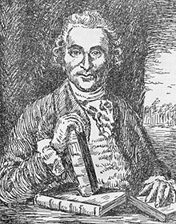
Lind and the scurvy experiment (1747)
Scurvy and sailors
Source: Wikipedia

Slide 17
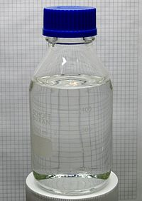
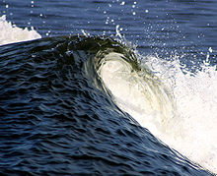
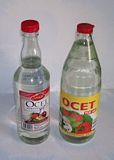
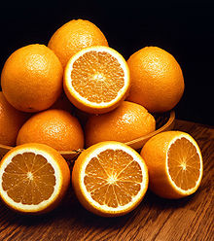
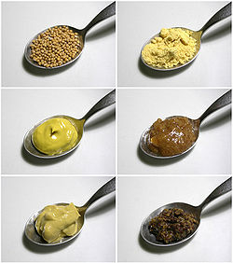
Lind and the scurvy experiment (1747)
Lind picked 12 crewmen who suffered from scurvy and divided them into 6 pairs.
Each pair received a different treatment:
1. a few drops of sulfuric acid | 2. a quart of cider | 3. half a pint of seawater
4. a spicy paste plus a drink of barley water | 5. six spoons of vinegar | 6. two oranges and one lemon

Slide 18
Heuristics and Biases
Part 2

